Slide 1

By
Sharan, Shrinidhi, Shruthi and Swathi

Slide 2
INTRODUCTION
The project is based on an Online Library management portal.
There are two modes- the user and the admin modes.
At runtime, one is allowed to login as an admin (librarian) or a user (borrower). The program keeps track of the books available, the user who hold an account, the books borrowed by each individual user, and the fine that is due by him.
The admin is allowed to add new books to the library. He/She is also has the access to all member details and their book issue status.
Whenever a member logs in, he/she gets a message whether he has any outstanding book and the amount of fine that he has to pay.

Slide 3
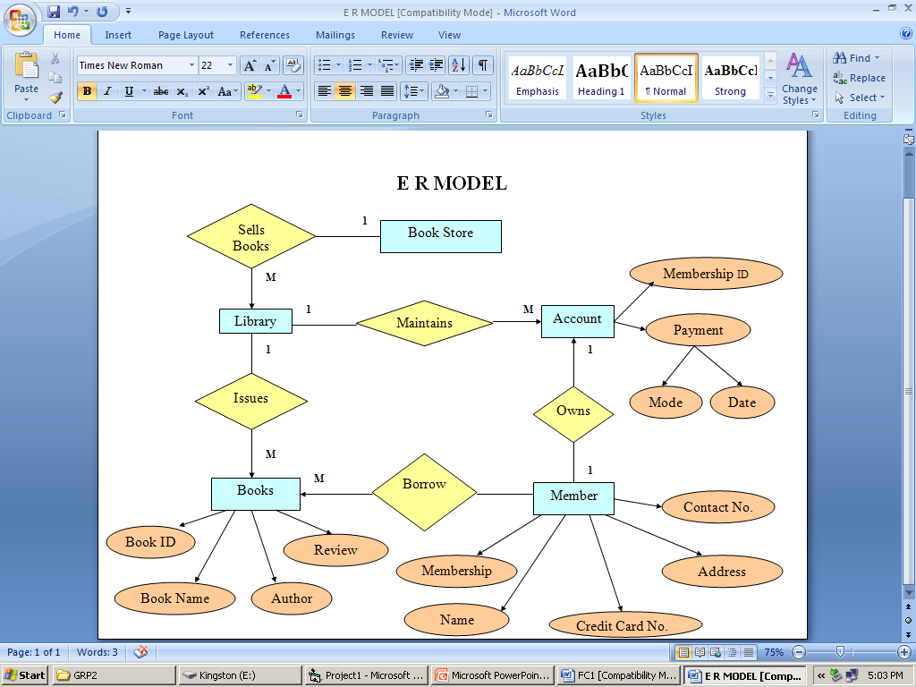
Various Stages of Planning

Slide 4
BORROWING BOOKS
The ER Model displayed in the previous slide, encompasses all the criterions we initially considered to simulate an offline Library.
The ER Model demonstrates the logical flow we adopted.
Most of the requirements stated in the model were realised.
However certain things like account maintenance have been considered for future scope of improvement. Also, trivial stuff like book store have been omitted.
The main operations of borrowing, user login, admin login have been taken care of.

Slide 5
IMPLEMENTATION
The project uses various data structures such as trees, linked lists as well as arrays to efficiently manage the data.
Each new title added by the librarian will be stored as a node in the tree. Every new copy of an existing title will be added to that title node by means of a linked list
For every title/copy added the program will generate a unique ID.
Status for a given book is maintained using a boolean flag.

Slide 6

Book Tree Simulation
“NightFall”
0-405-30902-1
1
2
“Knife of Dreams”
0-278-31887-5
“Silimarilion”
0-623-42568-9
1
2
1
2
“Hobbit”
0-211-13892-3
“Rakkety Tam”
0-545-62575-5
“Strong Medicine”
0-666-86568-4
1
2
1
2
1
2
“Old Man’s War”
0-437-36922-7
1
2

Slide 7
User List Simulation
“Sanjay”
Books Borrowed:
“Hobbit”
“RakketyTam”
“Old Man’s War”
“Adam”
Books Borrowed:
“Strong Medicine”
“Hobbit”
“Steve”
Books Borrowed:
“Nightfall”

Slide 8
INTERFACE
The admin is allowed to add new books to the library. He/She is also has the access to all member details and their book issue status.
Whenever a member logs in, he/she gets a message whether he has any outstanding book and the amount of fine that he has to pay.
The fine is generated by the program itself.
There is also a provision for both admin and user to search for a desired book and see its status (i.e admin can check if the book is overdue and member can check if the book is available to be borrowed)

Slide 9
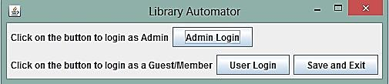
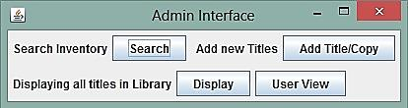
Main Login Screen

Slide 10
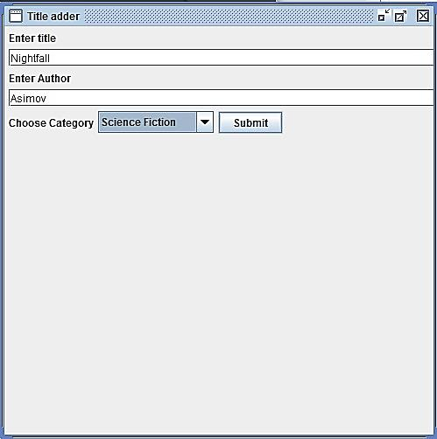
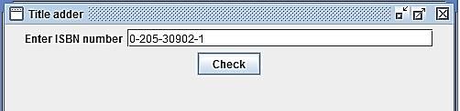
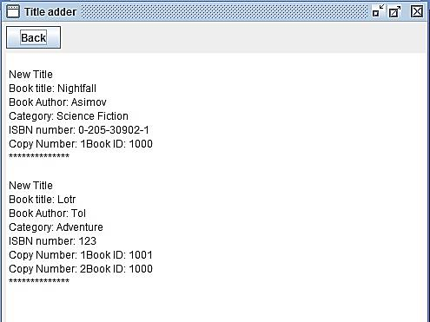
Admin Interface
ISBN Adder:
Display:

Slide 11

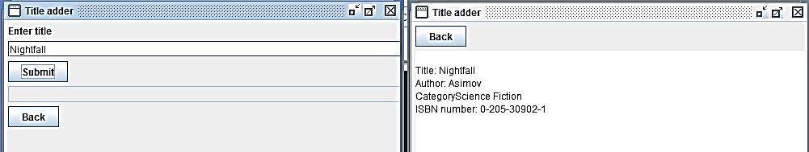
Admin Interface
Search:

Slide 12
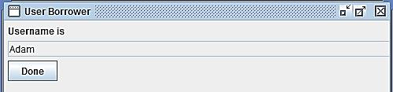
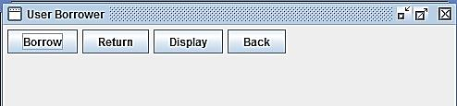
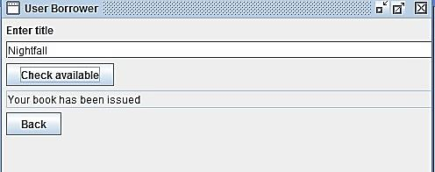
User Interface
User Login Setup:
Borrowing in Process:

Slide 13
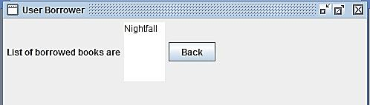
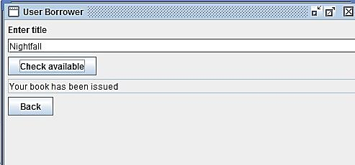
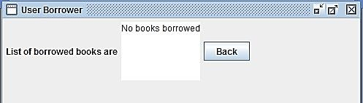
User Interface
Before Return:
Returning:
After Return:

Slide 14
CONCLUSION
This project reduces use of paper and minimizes the labor for the librarian.
It also ensures mobile library access for members, although they must be physically present to borrow/return a book.
Utilizes search and sort techniques optimally to guarantee efficient running of the library portal.

Slide 15
THANK YOU

